Slide 1

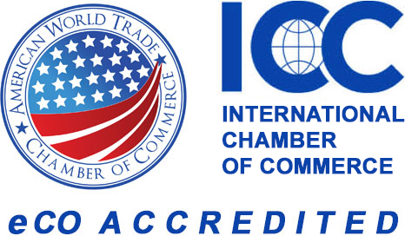
Export Certifications and Rules of Origin
In partnership with
The American World Trade Chamber of Commerce (AWTCC)

Slide 2
AWTCC - Who are We?
Export documentation partner of Irvine Chamber
U.S. chamber with their entire staff certified by ICC
U.S. Delegate to ICC WCF International CO Council
First U.S. Chamber admitted to ICC WCF International CO Accreditation Chain ensuring integrity and compliance with worldwide verification
Major US organization issuing non-preferential COs

Slide 3
The Cover Letter to your shipment
A Certificate of Origin (CO) is a document attesting that goods exported in a shipment have been wholly obtained, produced, manufactured or processed in a particular country. COs may be requested by customs administrations, importers, freight forwarders or banks for clearance of letters of credit.
The certificate of origin serves as the cover letter to all other documentation and often will give the first impression of the rest of the supporting documents.
Origin is used when determining what duty will be assessed on the goods or, in some cases, whether the goods may be legally imported at all.

Slide 4
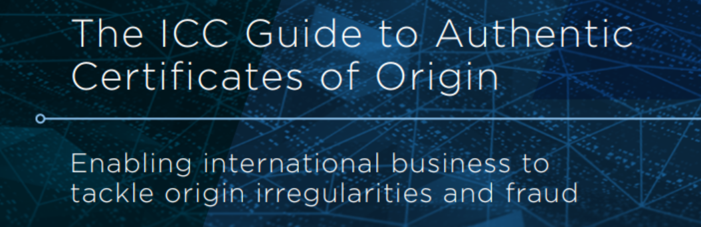
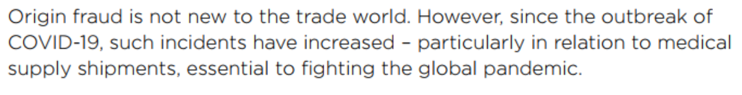
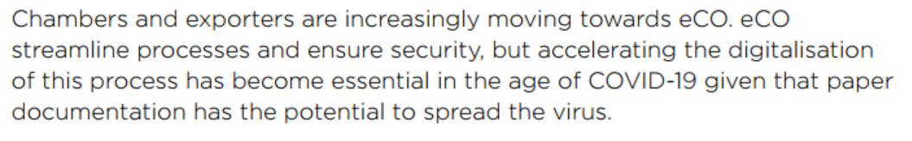
Origin – Becoming more important
World Trade Organization (WTO) standards for Most Favored Nation (MFN) becoming less reliable
United States is a player in this change, but not everything is US centric
International sanctions leading to new enforcement ex. Netherlands
Trade deals between foreign nations leading to enforcement ex AfCFTA
Increase in fraud leading to more documentation scrutiny

Slide 5
Forecast and Challenges
Origin mistakes are extremely common – this went unnoticed during the MFN era
US companies are looking at new countries and buyers, likely leading to a sharp increase in letter of credit requests
Importers and exporters alike are attempting to manage past mistakes in origin claims
More rules enforcement for non-preferential COs
FTA declarations more likely to be scrutinized

Slide 6
‘Made In’ vs ‘Origin’
Origin reflects a complete value
A product can be 50% made in USA but will only ever have 1 origin
For tomato sauce, not relevant where tomatoes, basil, or garlic grown. Only relevant where sauce is made*
Origin does not have percentage or threshold requirements*
Origin determinations tend to follow standards set by the International Chamber of Commerce *
Made in determinations are based on country specifics*
*Free Trade Agreements (FTAs) and country specific rules will always take priority

Slide 7
FTAs - High Level
Each agreement is unique
Total or partial elimination of duties
3 ways to typically qualify
Wholly obtained or produced in FTA country
Obtained – Manufactured goods
Produced – Mineral, vegetables
Made up of components and materials that originate in FTA country
USMCA – Multi-country agreements
Meet other requirements or product specific rules of origin
Often a percentage threshold

Slide 8
Origin in FTA vs Non-preferential
Non-preferential
FTA
Based on standards set by the International Chamber of Commerce (ICC)
Relevant when no free trade agreement involved
Origin based on substantial transformation and tariff code switch
Stamped by AWTCC
Origin outlined within the text of the agreement
Generally, follows percentage-based thresholds to qualify
Presently, all US FTAs outline the CO as a self certified document
AWTCC can provide templates

Slide 9
US FTA – Origin Declarations
Certificate of Origin (CO) tends to be self certifying, not guaranteed to be the case always
CO tends to not have dedicated forms, not guaranteed to be the case always
Helpful to use pre-made templates
Importer often provides an option
eCO changes for USMCA
Some FTA texts will require dedicated CO form, others may just need a declaration
Importer may request more documentation – it’s up to you to balance
Full Text of agreements and specific origin requirements will be available on trade.gov
For USMCA
Origin needs to be a simple declaration on invoice or separate form
No dedicated form – templates available from Shipping Solutions
Electronic origin declarations to be accepted by importer and exporter
HS shift method less reliable, rules around regional value content (percentages)

Slide 10
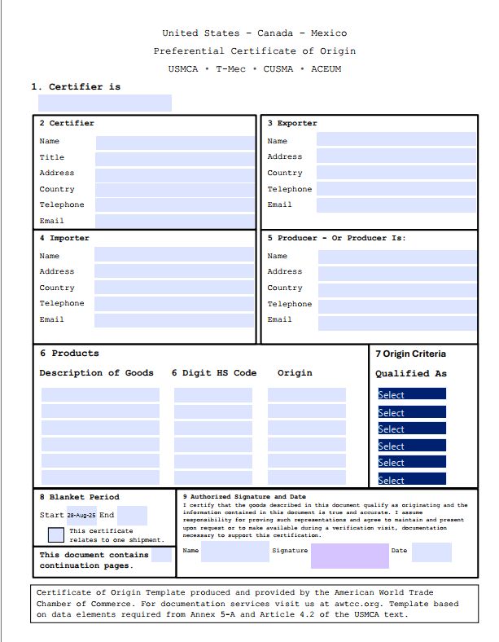
Preferential COs
AWTCC can provide preferential templates.
Often, a full form CO is not required but as a lot of information is required we recommend best practice is to generate a full form document.

Slide 11
Non-Preferential Certificates of Origin ICC – Setting the standard
Commonly issued by chambers of commerce
Often specifies ‘local’ chamber, meaning a chamber operating in the exporting country
International Chamber of Commerce (ICC) sets standards and best practices alongside the World Chambers Federation
ICC maintains CO verification website for accredited chambers
Non-preferential doesn’t mean to skip CO
Often requirement for clearance
Most favored nation priority

Slide 12
What We Cover – Electronic Process
Certificates of Origin
(non pref)
Certificates of Free Sale
Commercial Invoices
Embassy Legalization
Plus Feedback

Slide 13
Substantial Transformation HS Code Shift
Qualifies
Does not qualify
Tomatoes, onions, basil, and garlic imported from all different countries than turned into tomato sauce
Electronic components from different countries turned into computer
Individual piece is not the final product
Repacking existing product
Diluting tomato sauce with water
Putting a new label on a jar of tomato sauce
Freezing imported tomatoes
Phone with case added (may be mixed)
May Qualify
Assembly/Disassembly

Slide 14
Current State of Electronic
“The issuance of a CO is 100% electronic in China. All eCO issued by CCPIT and its branches are accepted by customs agencies around the world with more than 4 million CO delivered in the country every year. CCPIT encourages all chambers to go digital for the beneﬁt of their exporting business communities.”
“When we receive shipments from America, it is still difficult to clear goods at times due to the requirement for original documents—specifically because the Certificate of Origin is not provided digitally. Could you clarify why this has not been updated?”
Importer in UAE
Tingting Sun
Trade Facilitation Specialist
China Council for the Promotion of International Trade (CCPIT)
The majority of COs issued in the US today are still done manually.

Slide 15
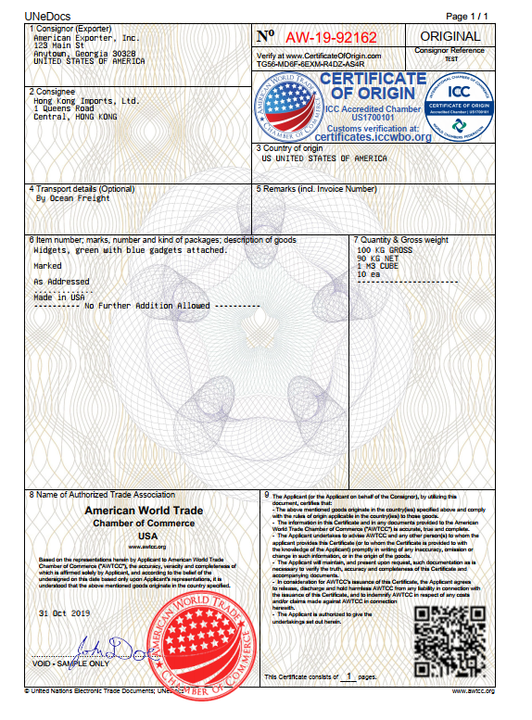

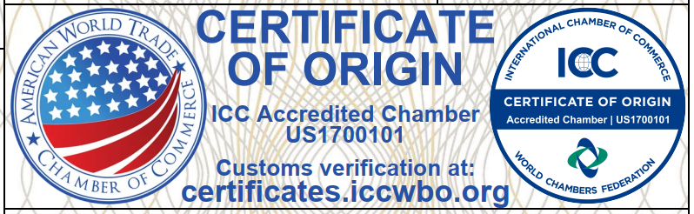

Verification

Slide 16
Electronic Certification
Value to Exporters
Apply and print at their desk - saves exporters on couriers, time, postage, parking
Web-based saving exporters on document creation time, training, repetitive applications
Compliance features reduce shipment delays and storage fees due to incomplete documentation
Fast and secure
Online Archive with audit trail, fully searchable database and attachments
Future-proof

Slide 17

Register today
https://greaterirvinechamber.com/business-resources/export-documents
Thank you!
Alex Sonifrank
VP Partnerships
asonifrank@awtcc.org

